Slide 1

HappyRobot 2025 Team Offsite
Event Planning Deck
October 20, 2025
Powered by Nowadays

Slide 2
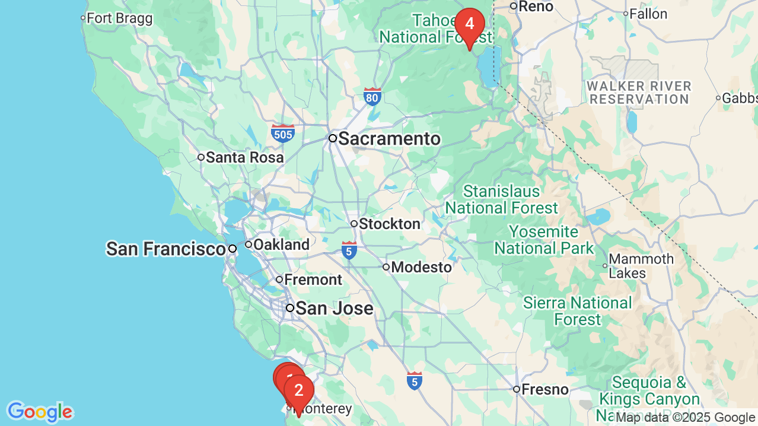
Venues Mapped
1. Hyatt Regency Monterey Hotel And Spa On Del Monte Golf Course
2. Carmel Valley Ranch - The Unbound Collection by Hyatt
3. Monterey Plaza Hotel & Spa
4. Everline Resort & Spa Lake Tahoe - Destination by Hyatt

Slide 3
Venue Pros & Cons
Hyatt Regency Monterey Hotel And Spa On Del Monte Golf Course
Carmel Valley Ranch - The Unbound Collection by Hyatt
Monterey Plaza Hotel & Spa
Everline Resort & Spa Lake Tahoe - Destination by Hyatt
Pros
• Insert pro
• Insert pro
• Insert pro
• Insert pro
Cons
• Insert con
• Insert con
• Insert con
• Insert con

Slide 4
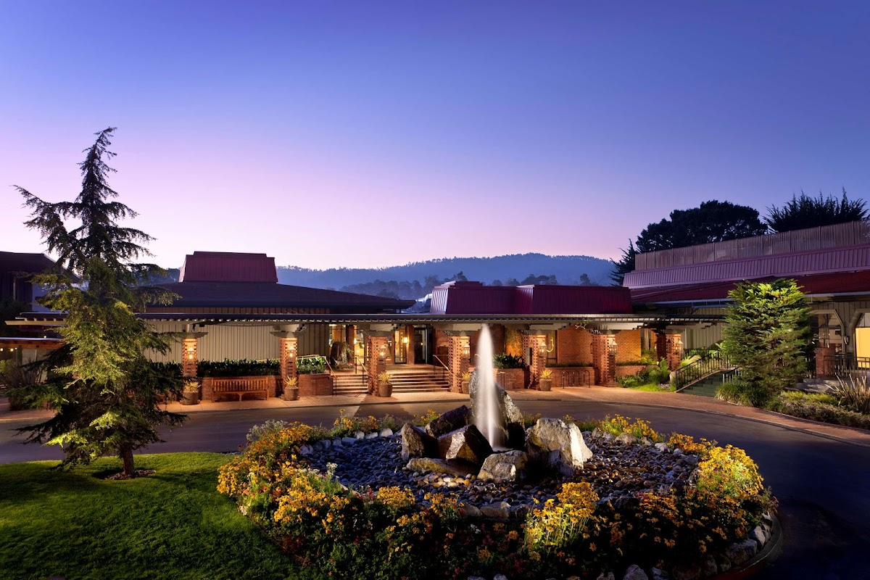
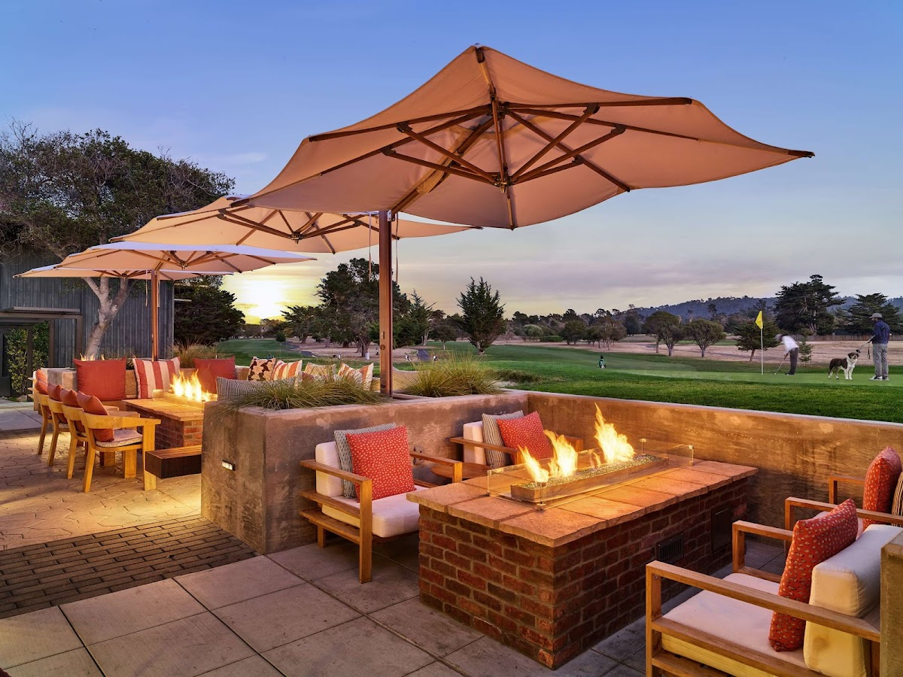
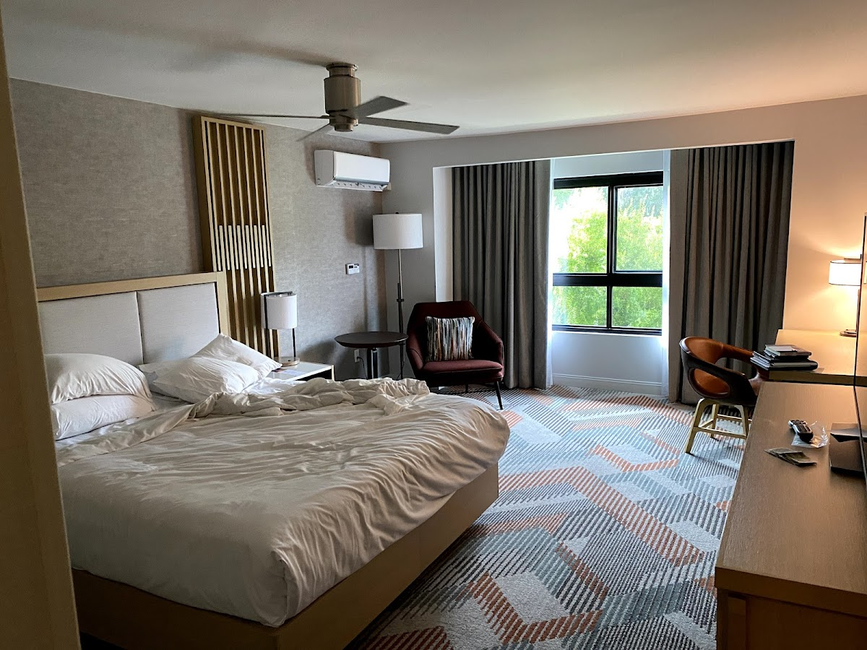
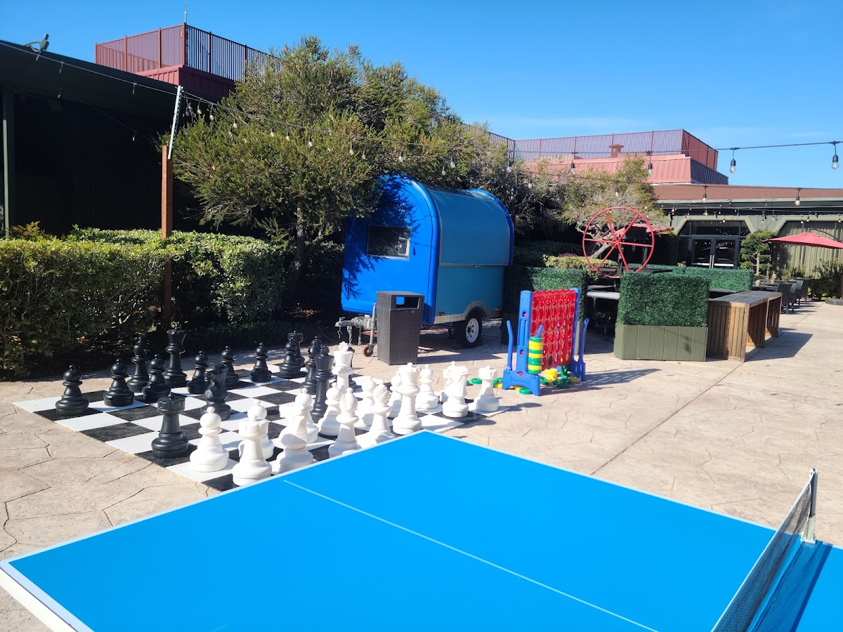
Option 1:
Hyatt Regency Monterey Hotel And Spa On Del Monte Golf Course
• Location: Monterey, California
• Distance to airport: 4 miles
• Guest rooms: 560
• Check-in: Oct 8, 2025
• Check-out: Oct 11, 2025
Notes: Available! soft hold till Friday Sept 12

Slide 5
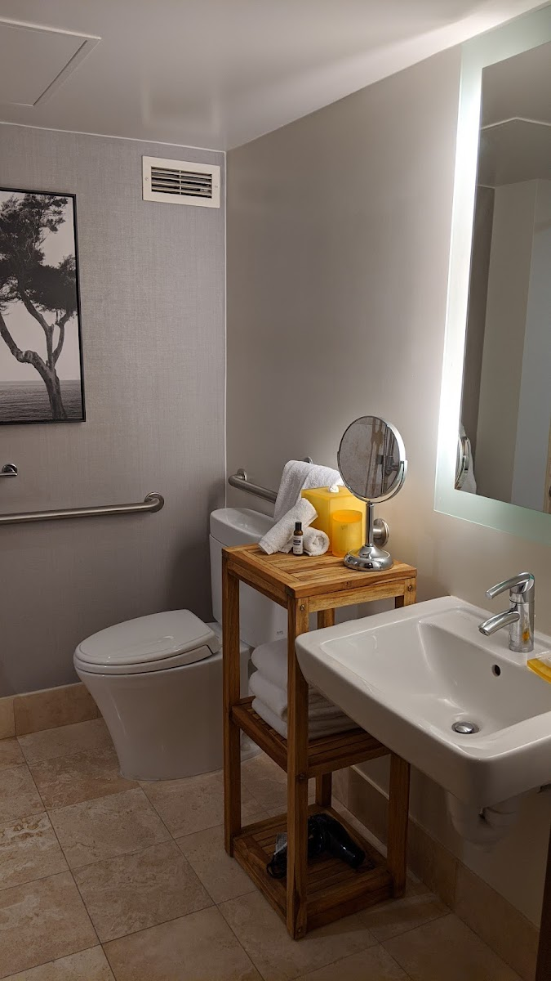
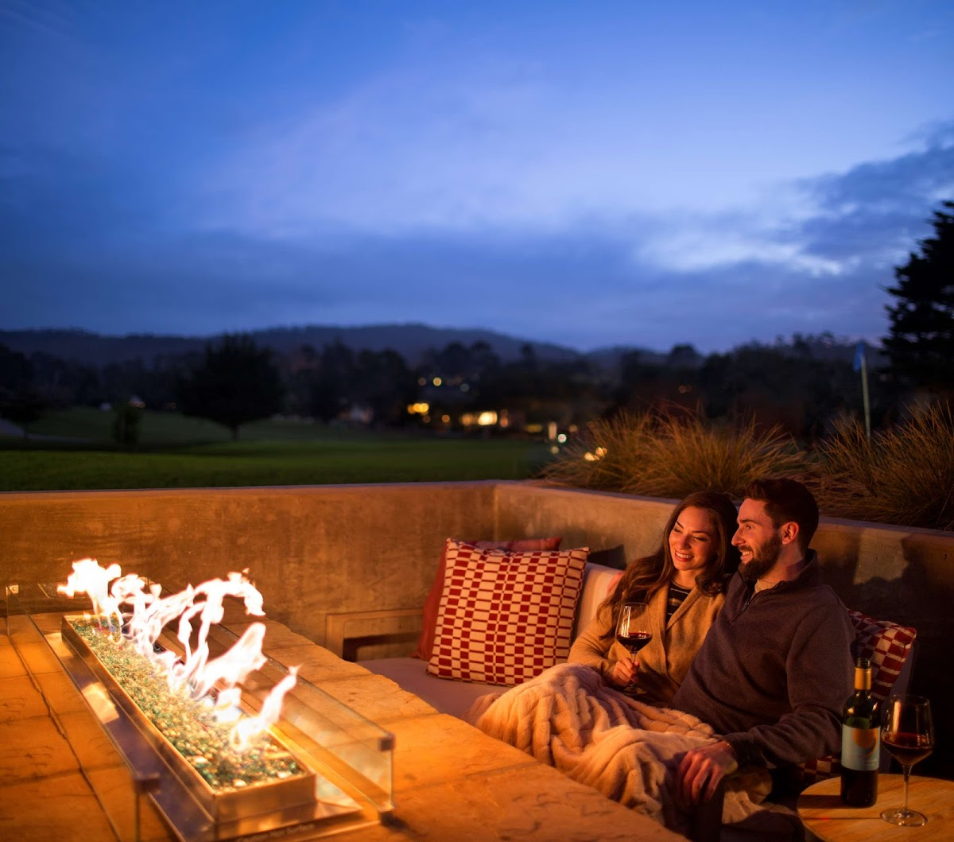
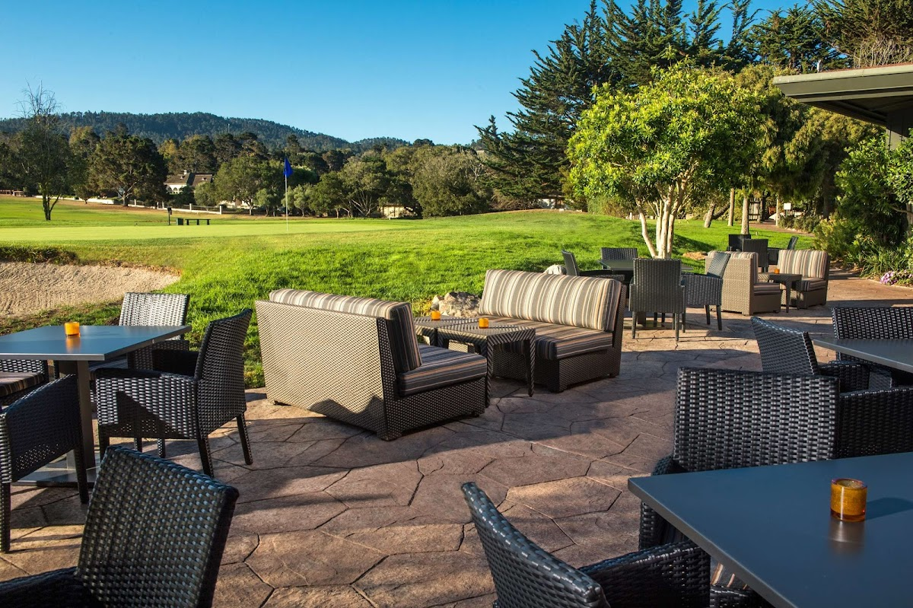
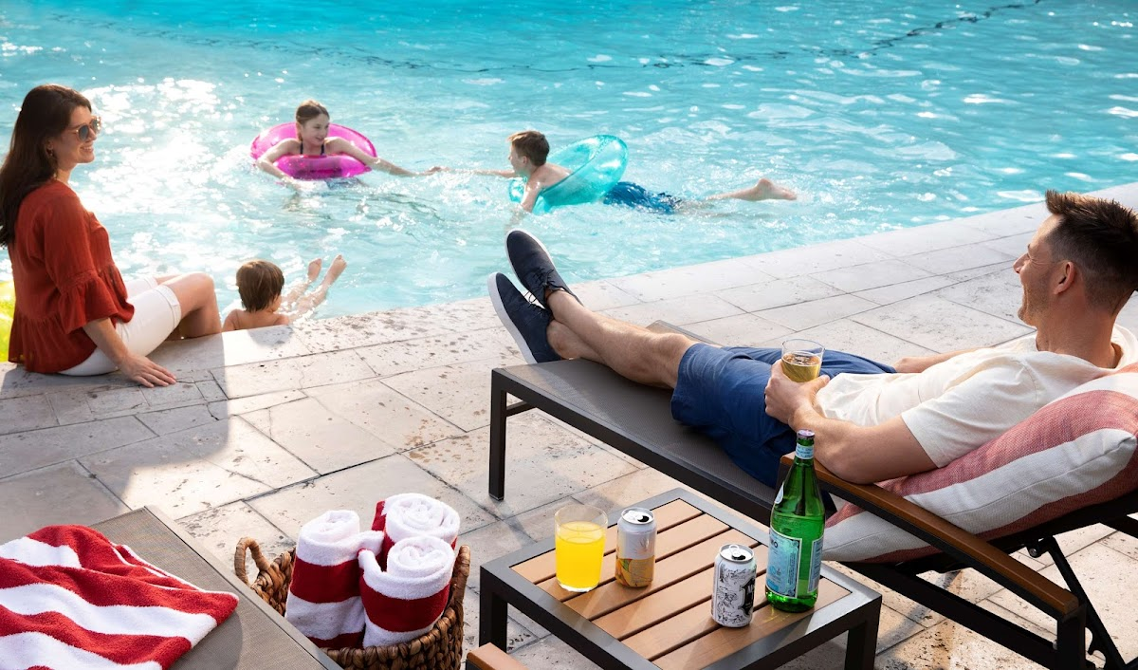
Option 1:
Hyatt Regency Monterey Hotel And Spa On Del Monte Golf Course
Nightly Rate
$369
Meeting Room Rate:
$0
F&B Minimum:
$7,000
Current Estimate:
$113,676

Slide 6
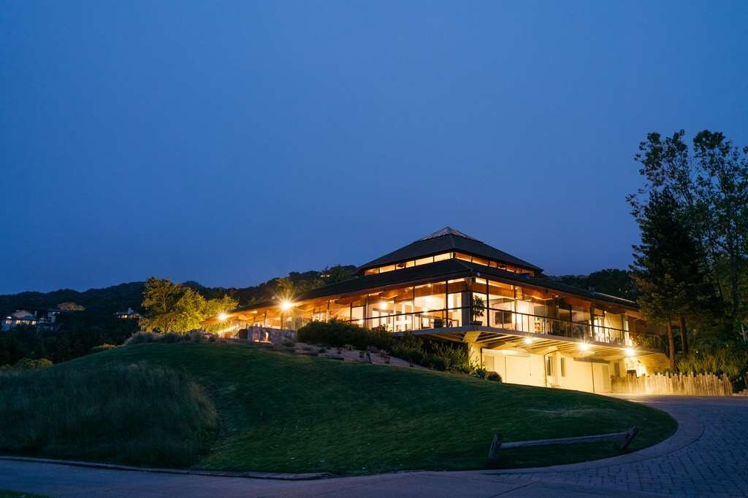
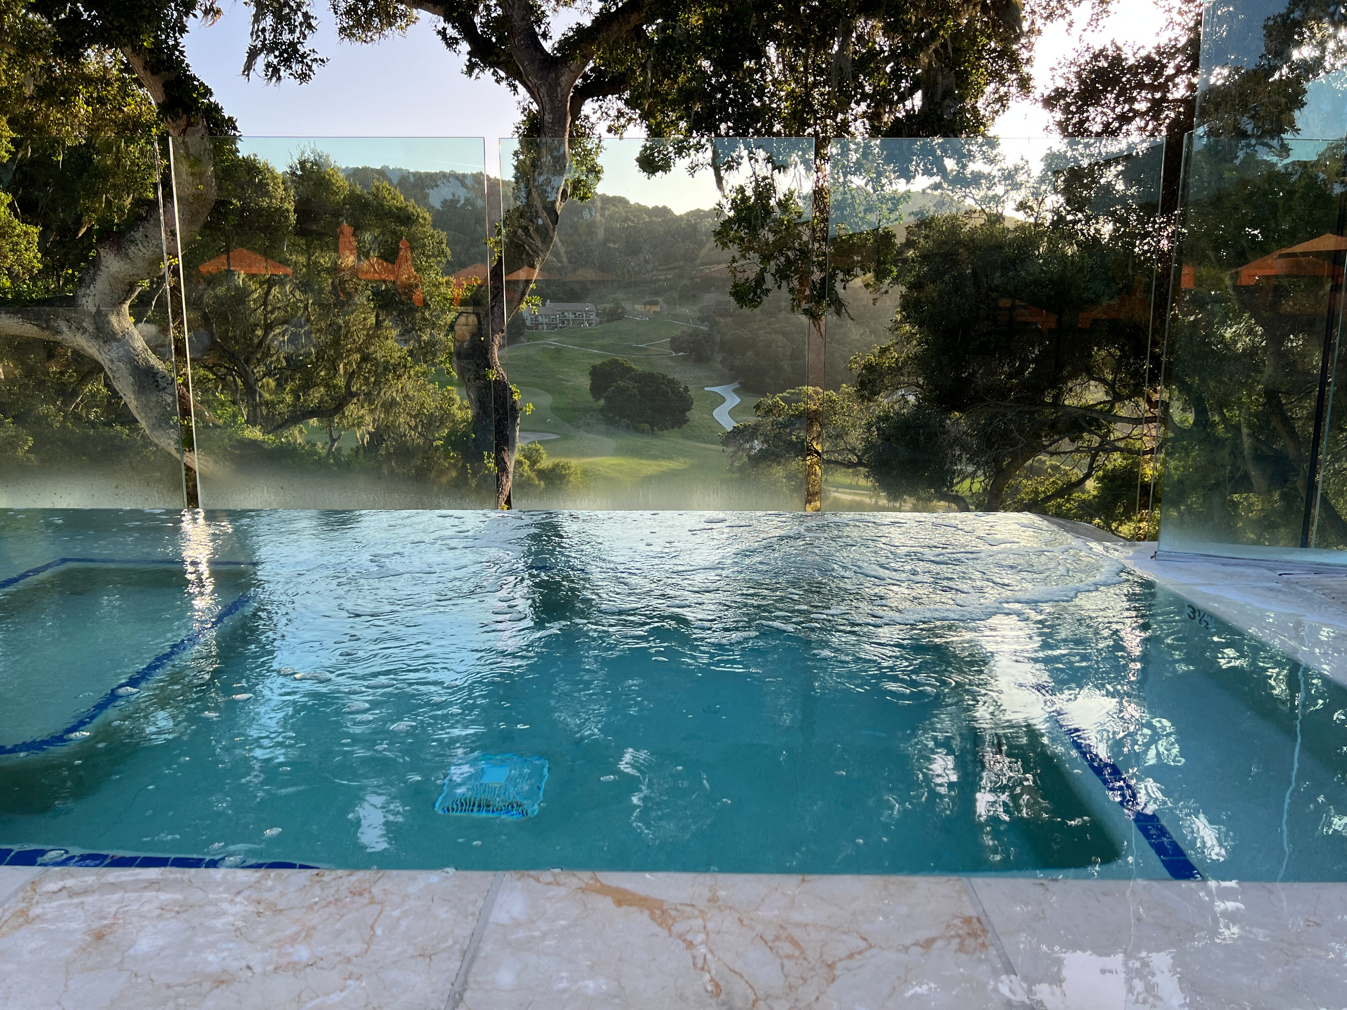
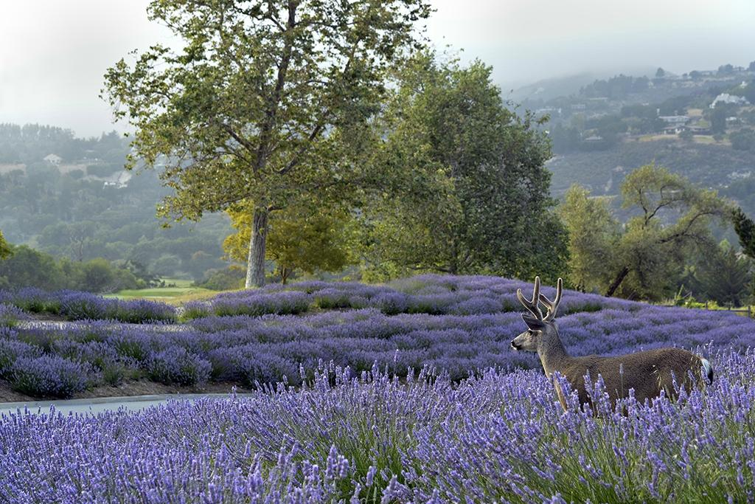
Option 2:
Carmel Valley Ranch - The Unbound Collection by Hyatt
• Location: Carmel-by-the-Sea, California
• Distance to airport: --
• Guest rooms: 179
• Check-in: Oct 8, 2025
• Check-out: Oct 11, 2025
Notes: ~30 double rooms available, can pair with Quail Lodge

Slide 7

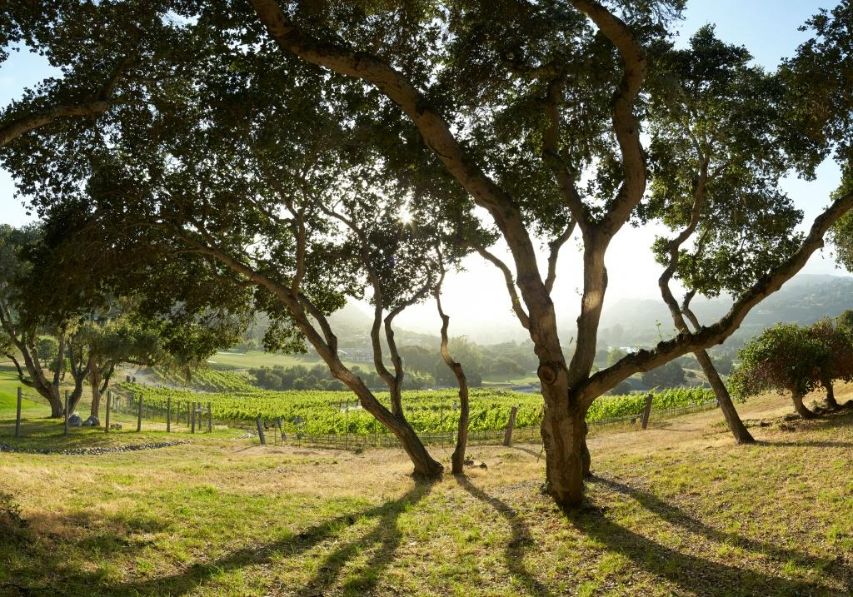
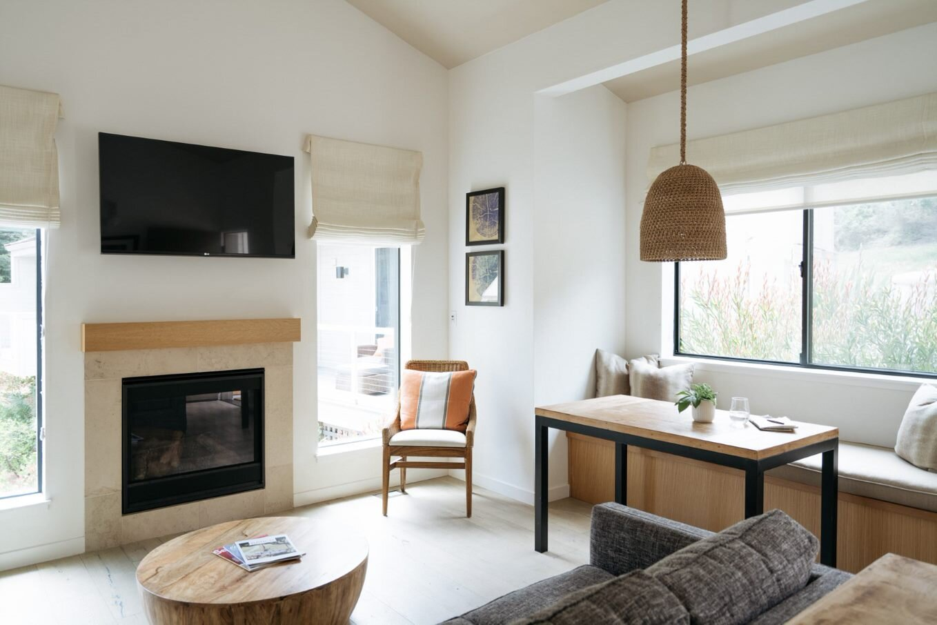
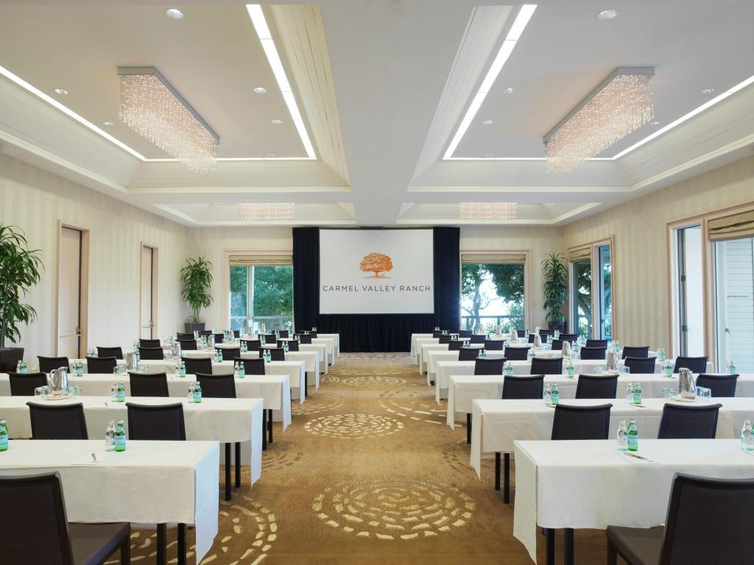
Option 2:
Carmel Valley Ranch - The Unbound Collection by Hyatt
Nightly Rate
$ TBD
Meeting Room Rate:
$2,500
F&B Minimum:
$ TBD
Current Estimate:
$102,564

Slide 8
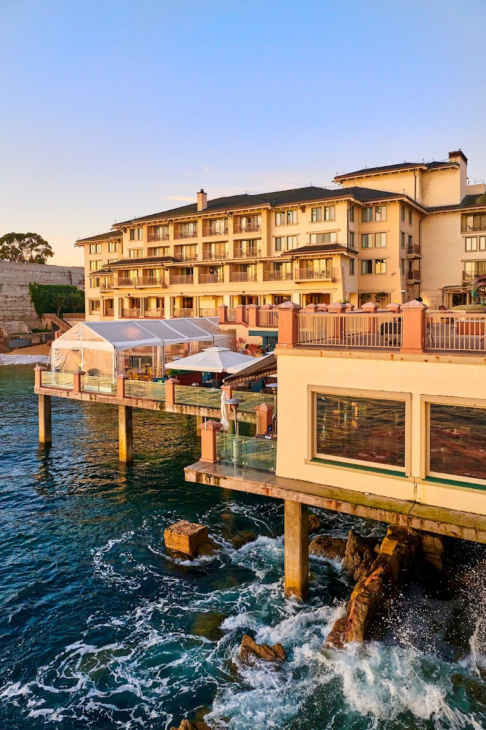
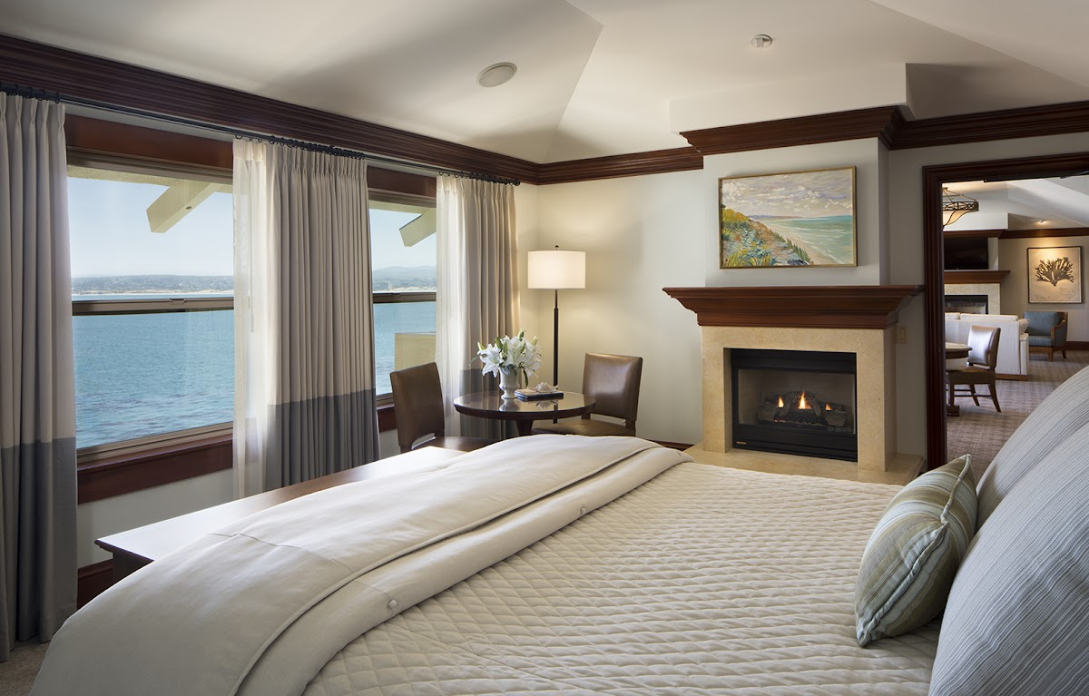
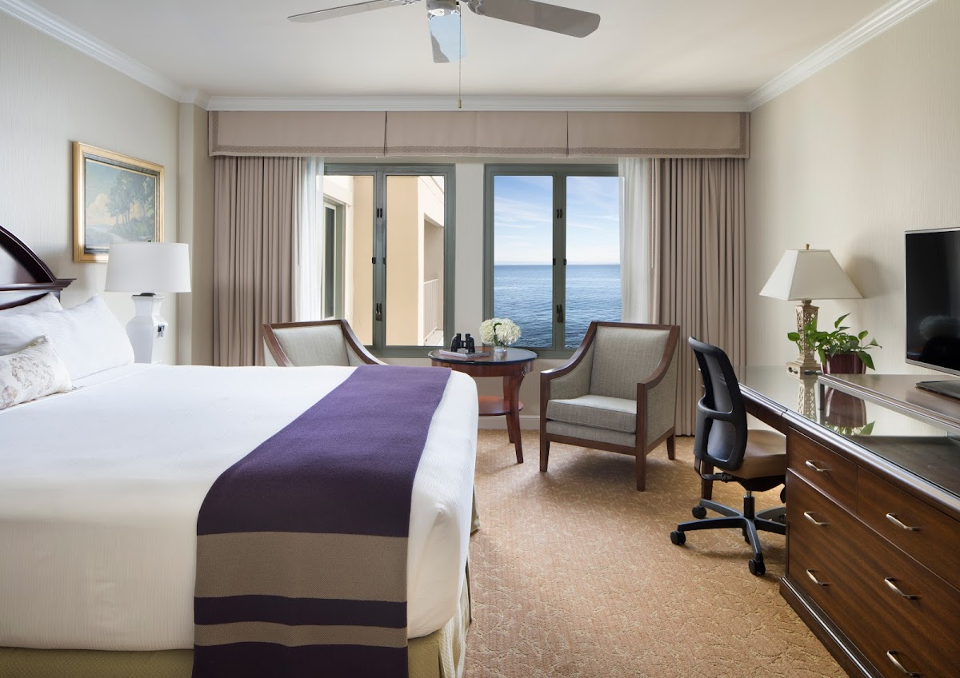
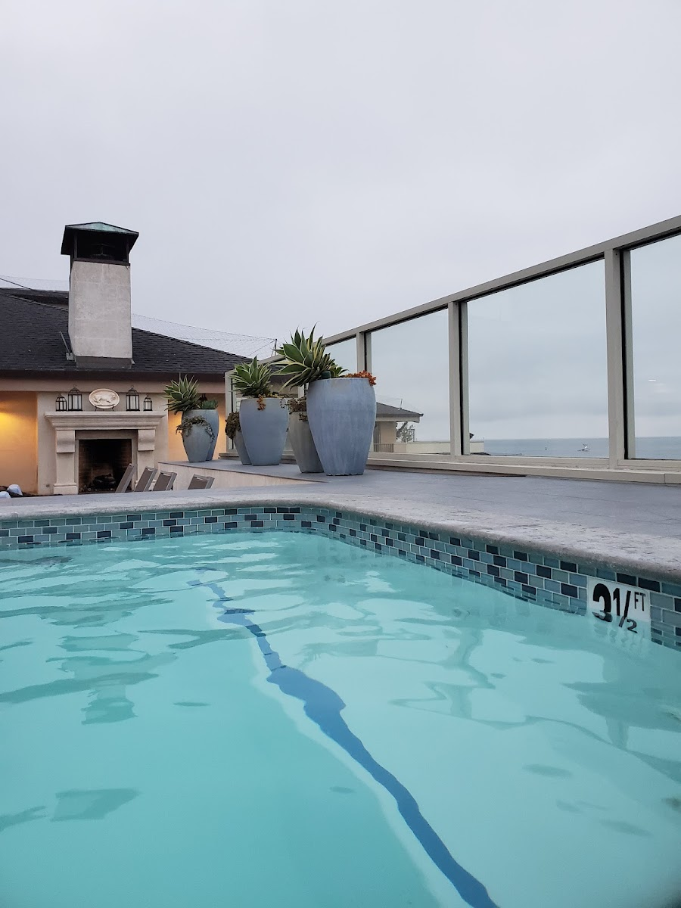
Option 3:
Monterey Plaza Hotel & Spa
• Location: Monterey, California
• Distance to airport: 5 miles
• Guest rooms: 285
• Check-in: Jul 26, 2025
• Check-out: Jul 31, 2025
Notes: Not available Oct 9 (only 20 rooms), can do 70 rooms Oct 10-12

Slide 9
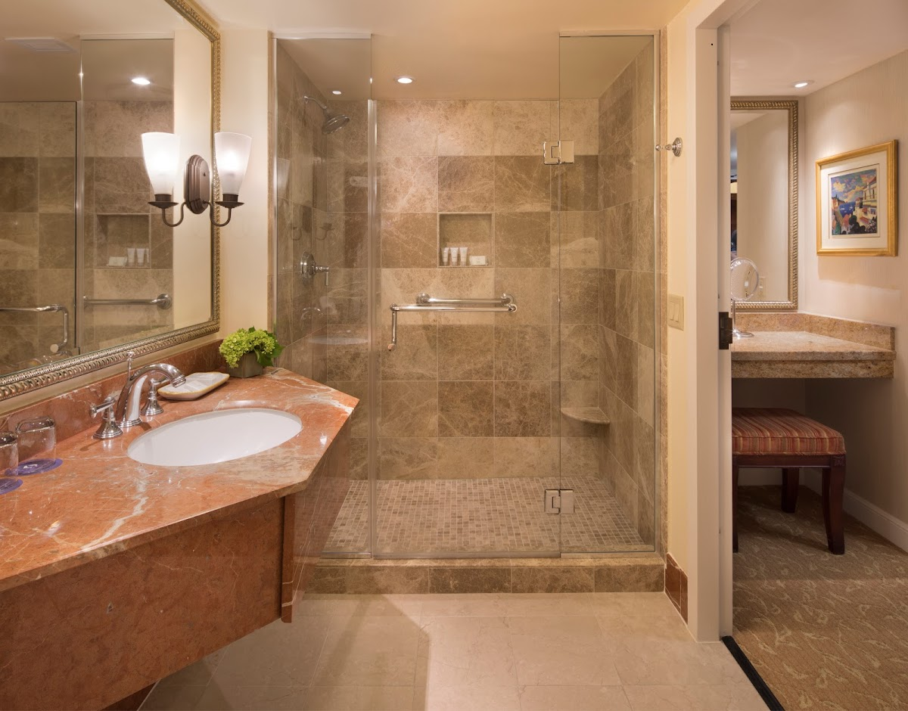
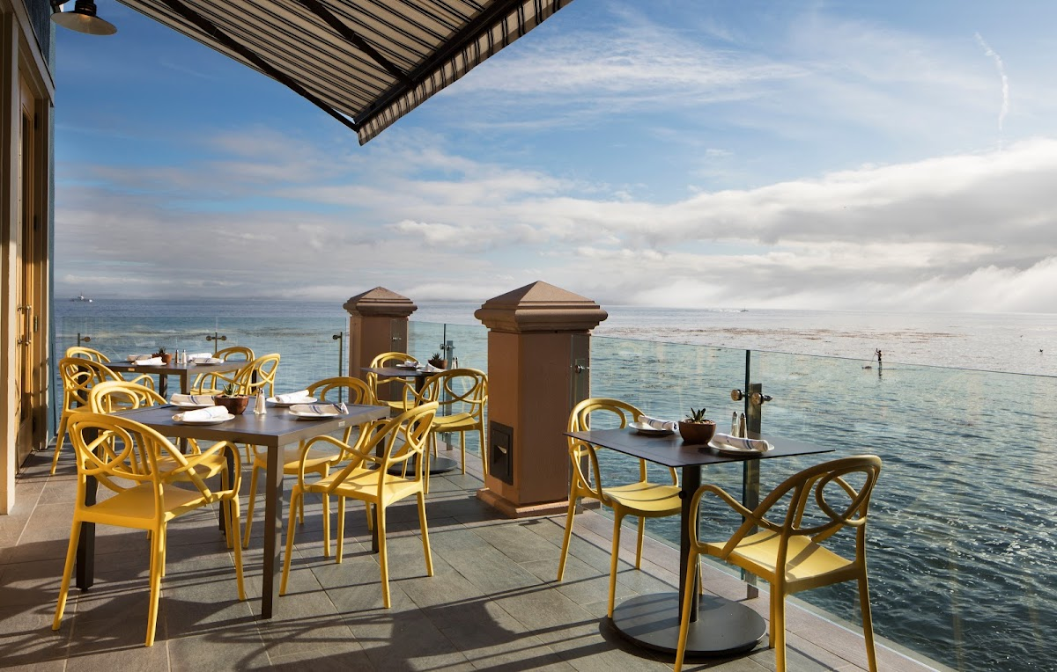
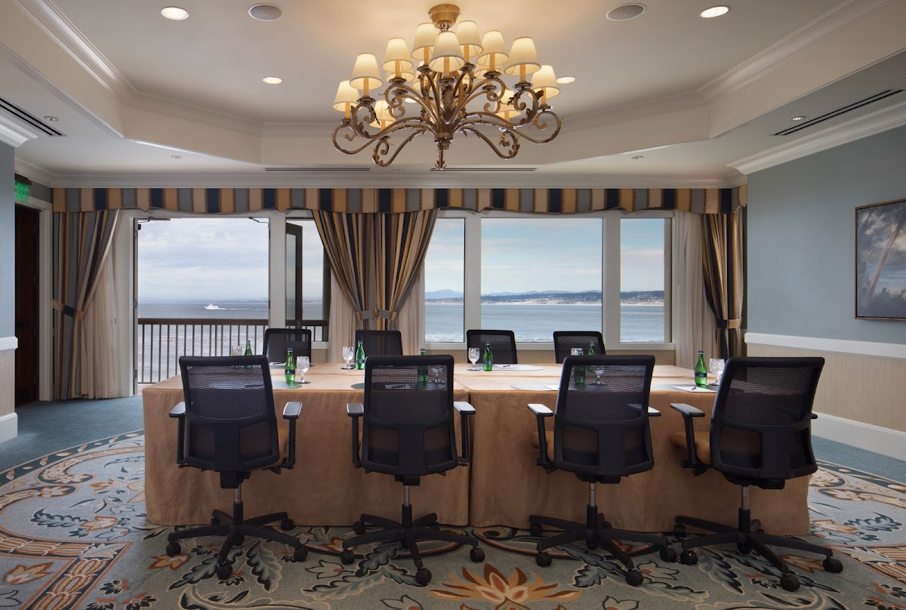
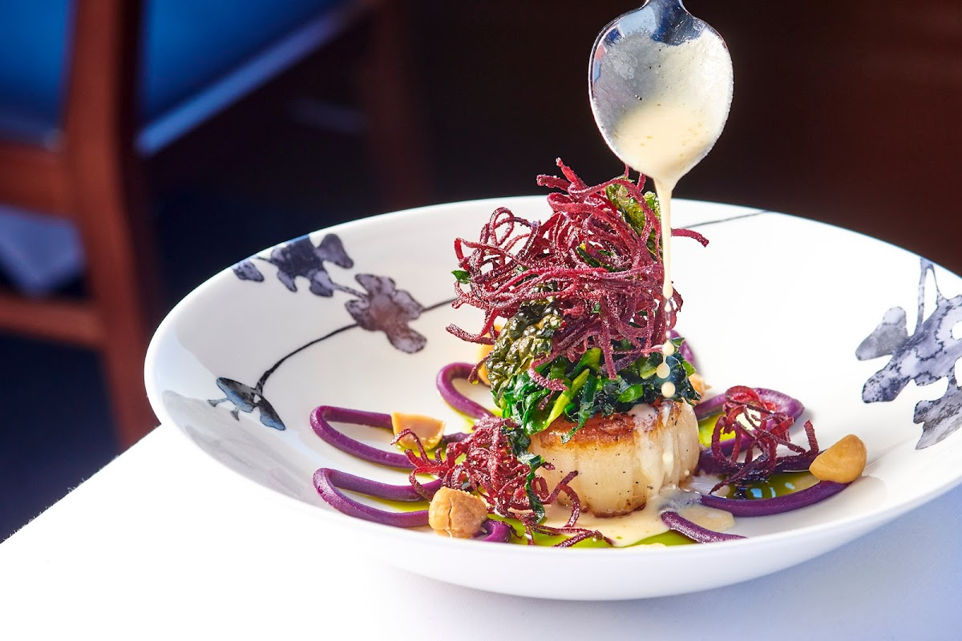
Option 3:
Monterey Plaza Hotel & Spa
Nightly Rate
$329
Meeting Room Rate:
$0
F&B Minimum:
$30,000
Current Estimate:
$168,849

Slide 10
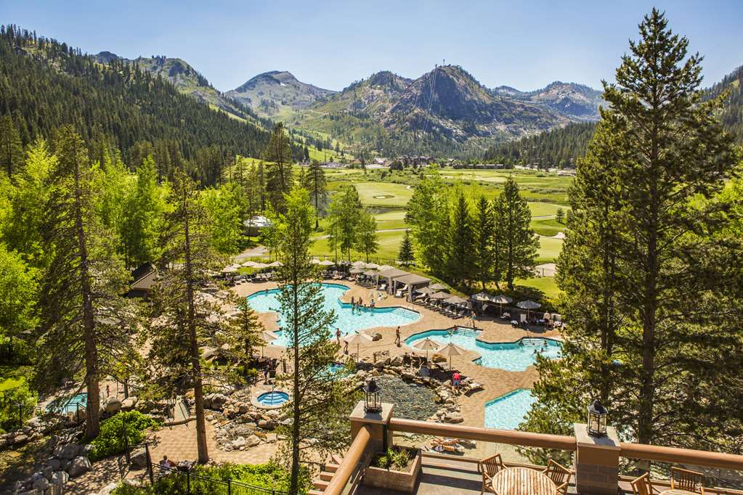
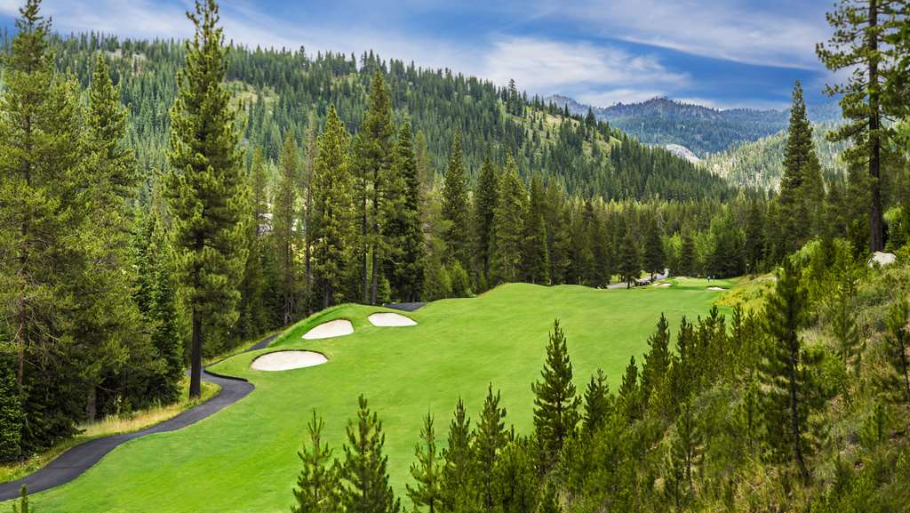
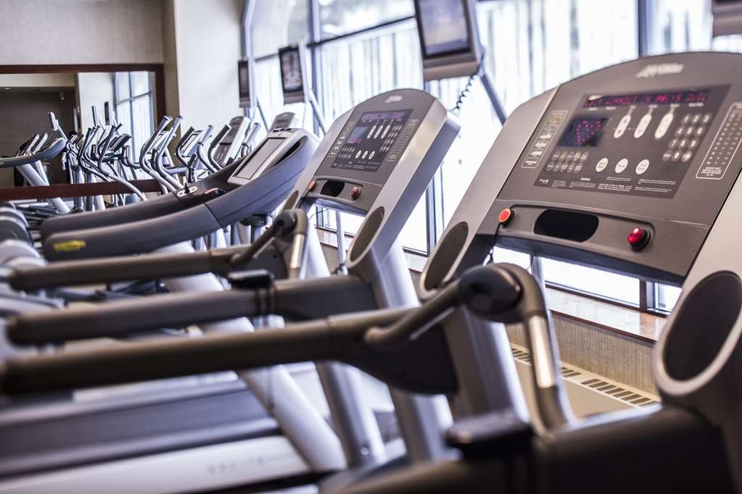
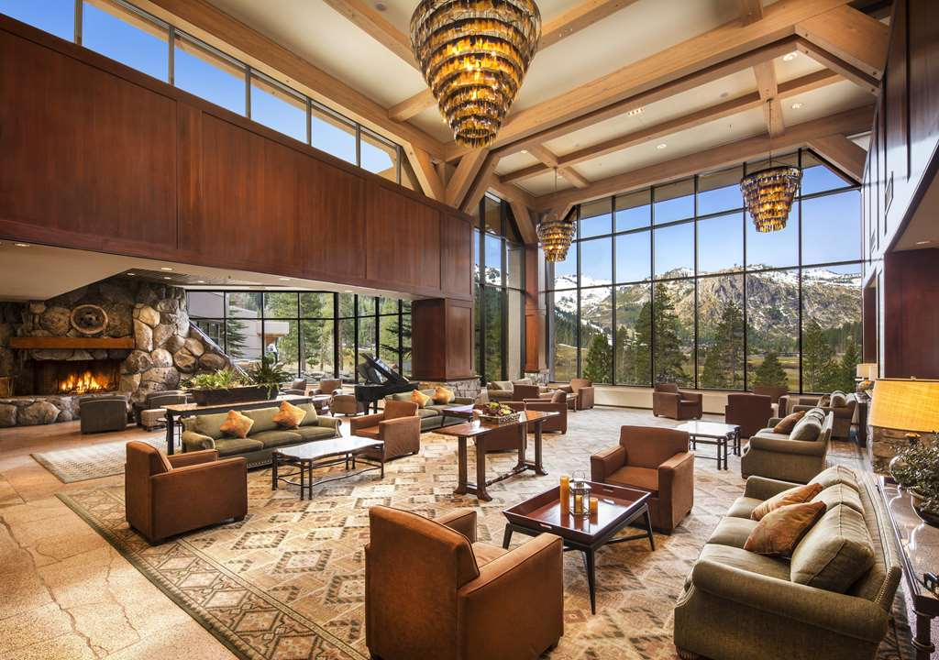
Option 4:
Everline Resort & Spa Lake Tahoe - Destination by Hyatt
• Location: Olympic Valley, California
• Distance to airport: --
• Guest rooms: 405
• Check-in: Oct 8, 2025
• Check-out: Oct 11, 2025
Notes: Available! Spa Deck

Slide 11
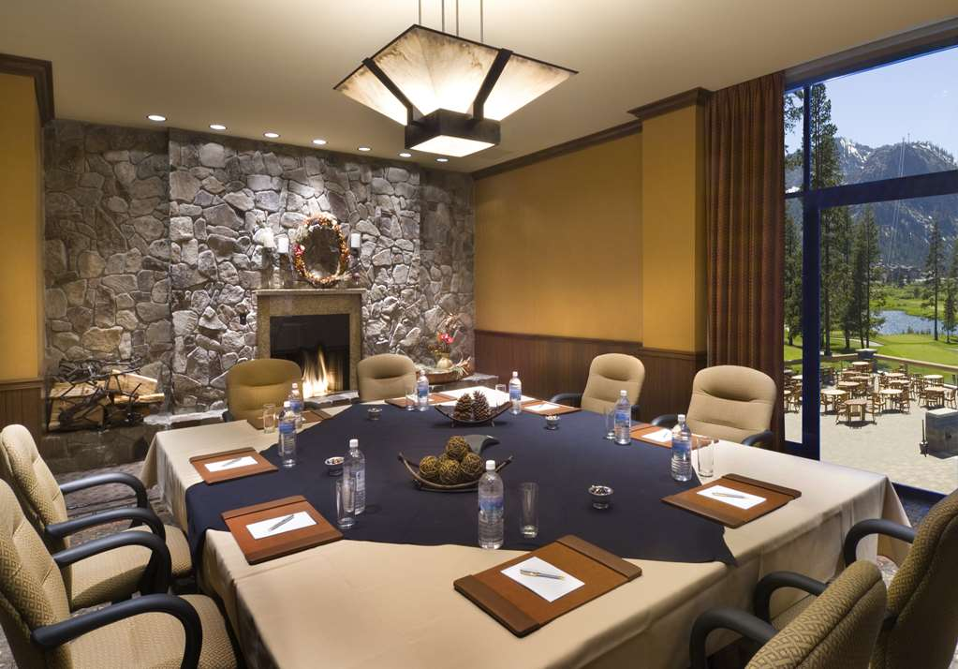
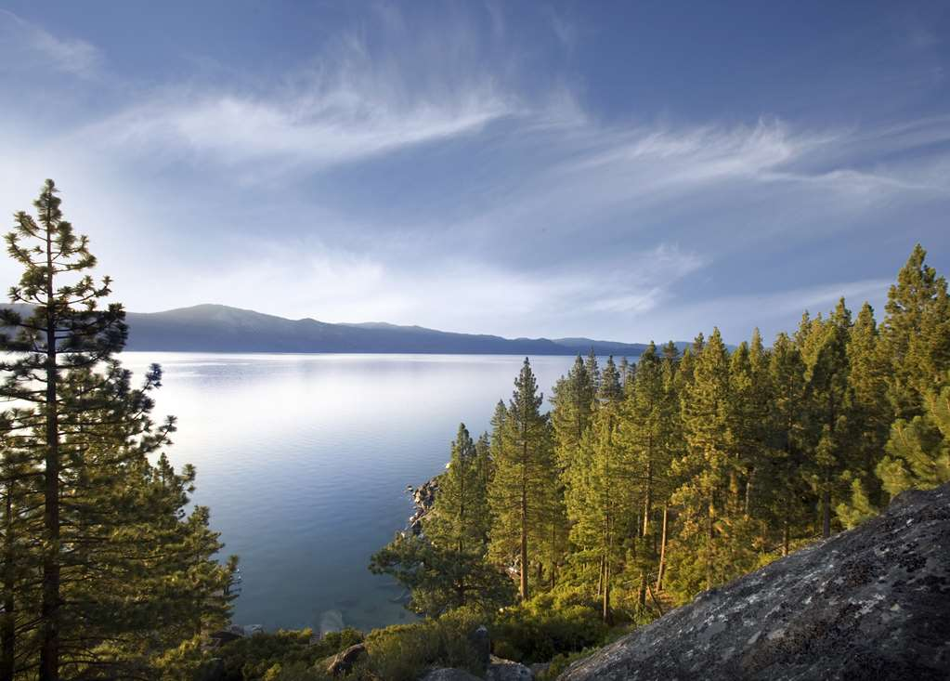
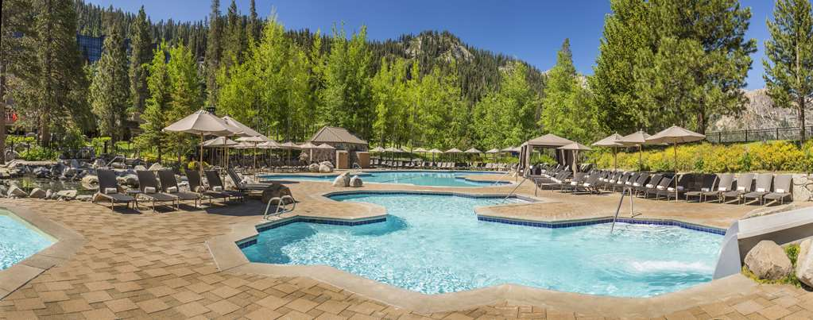
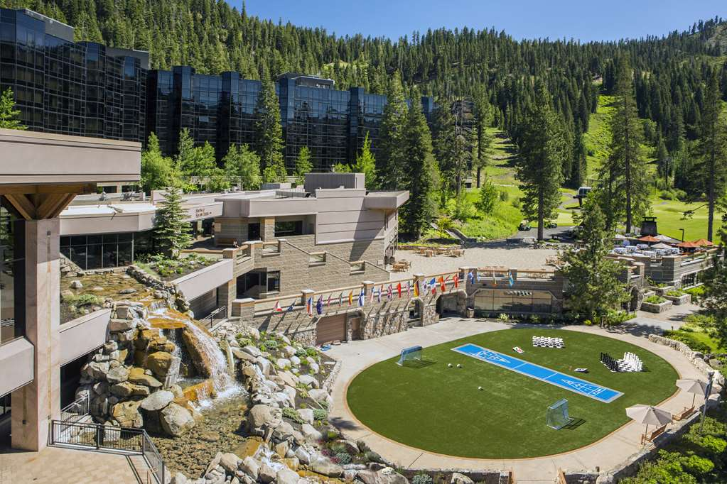
Option 4:
Everline Resort & Spa Lake Tahoe - Destination by Hyatt
Nightly Rate
$299
Meeting Room Rate:
$ TBD
F&B Minimum:
$ TBD
Current Estimate:
$126,521

Slide 12
Activities & Amenities
October 20, 2025
Powered by Nowadays

Slide 13
Activities & Amenities
•
•
•
•
Notes:

Slide 14
Conclusion
October 20, 2025
Powered by Nowadays

Slide 15
Venue Comparison
Hyatt Regency Monterey Hotel And Spa On Del Monte Golf Course
Carmel Valley Ranch - The Unbound Collection by Hyatt
Monterey Plaza Hotel & Spa
Everline Resort & Spa Lake Tahoe - Destination by Hyatt
Distance to Airport
4 mi
--
5 mi
--
Nightly Rate
$369
--
$329
$299
Meeting Room Rate
--
$2,500
--
--
F&B Minimum
$7,000
--
$30,000
--
Total
$113,676
$102,564
$168,849
$126,521
October 20, 2025
Powered by Nowadays

Slide 16
Thank you! :)
October 20, 2025
Powered by Nowadays

